Slide 1
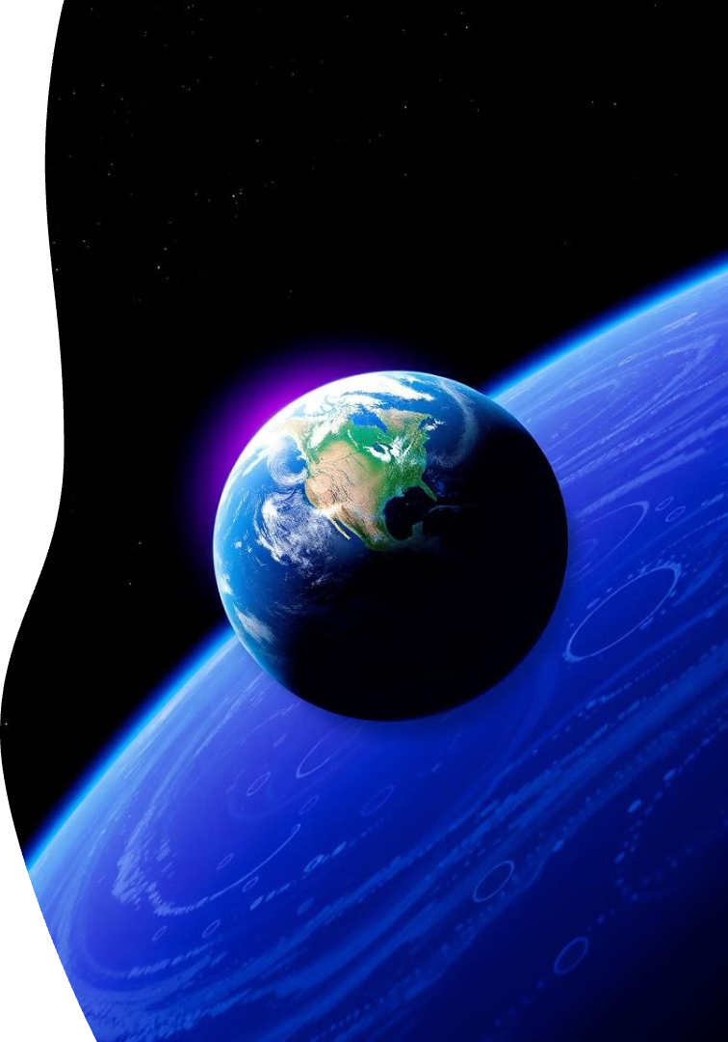

Orion’s shield
Galactic Games:
Fun in a Microgravity Environment!
Embark on an extraordinary journey through the cosmos with Galactic Games, a revolutionary space-themed game designed specifically for astronauts in the microgravity environment. Immerse yourself in an authentic experience that redefines the boundaries of gaming and space exploration.
Done By:
Tejashwini S Urankar
Atul K Mishra
Sanjay S Nayak
Advaith A Kashyap
Aditi D
Abhinav Singh

Slide 2
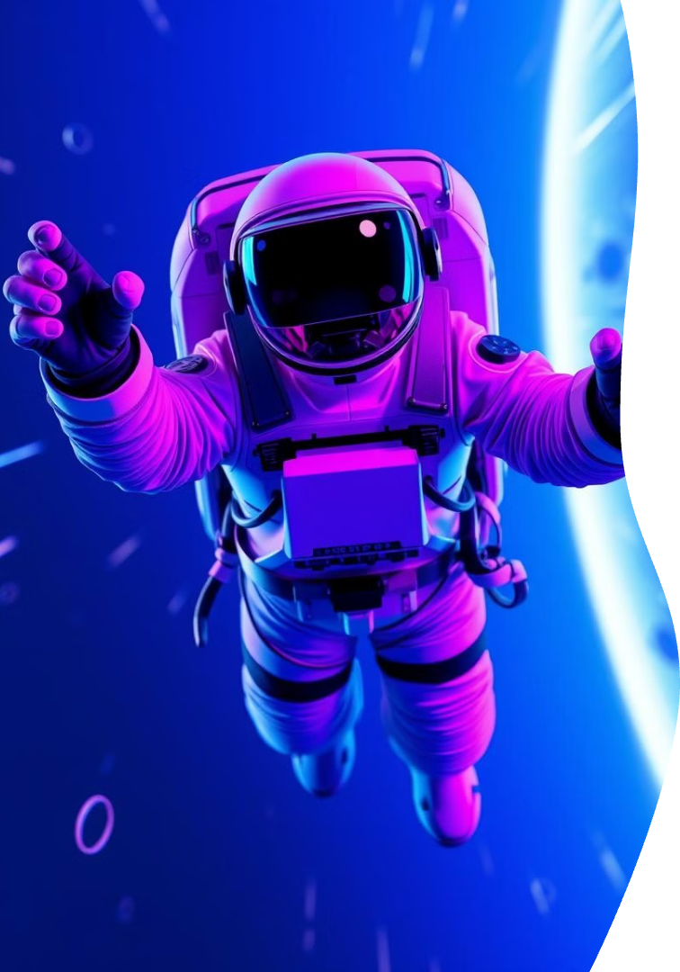

Orion’s shield
Immersive Gameplay in Microgravity
Micro-Gravity Controls
Multi-Sensory Experience
Intuitive motion-based controls designed for the microgravity environment, allowing astronauts to seamlessly navigate the virtual world.
Immersive VR visuals, haptic feedback, and spatial audio create a fully immersive experience that transports players to the far reaches of the galaxy.
Engaging Gameplay
Mini Games
By blending an engaging narrative with cognitive tasks, the game offers a meaningful and relaxing experience, aiding astronauts in maintaining their psychological health during long-term space travel.
The game includes mini-games like Galaga, Snake, and Chess, but places greater emphasis on informative experiences such as finding constellations and exploring stars and planets.

Slide 3
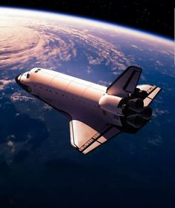

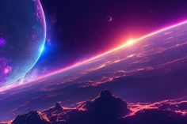



Orion’s shield
Breathtaking Visuals: A Journey through the Cosmos
Cutting-Edge Spacecraft
Alien Worlds
Galactic Vistas
Stunning 3D models of advanced spacecraft that capture the essence of modern space technology.
Explore a diverse range of extraterrestrial environments, each with its own unique characteristics and challenges.
Witness the grandeur of the cosmos, from majestic nebulae to the awe-inspiring expanse of the Milky Way galaxy.

Slide 4
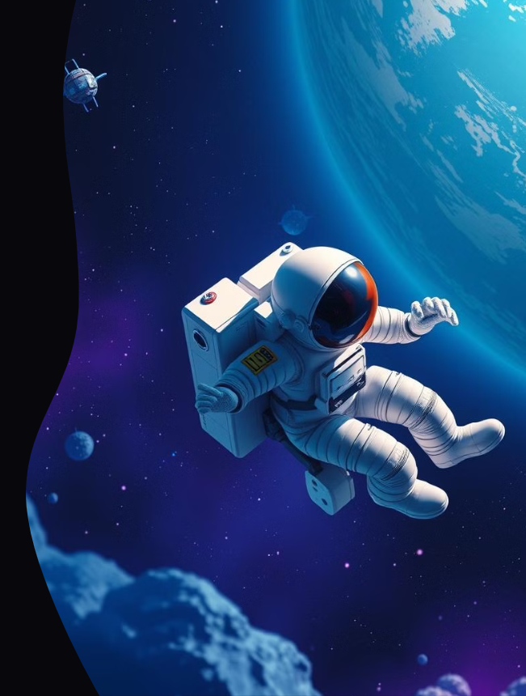





Orion’s shield
User Experience Designed for Astronauts
Mental Relaxation
Personalization
Calming ambient music is incorporated into the game to help astronauts manage stress, reduce anxiety, and promote relaxation during their long space missions.
Inclusive features and customizable settings to accommodate the unique needs of astronauts.
Exploration and Strategy
Educational Training
The high-stakes mission fosters a sense of purpose, which helps astronauts combat feelings of isolation during long space missions.
Opportunities to learn about space exploration and hone astronautical skills.

Slide 5
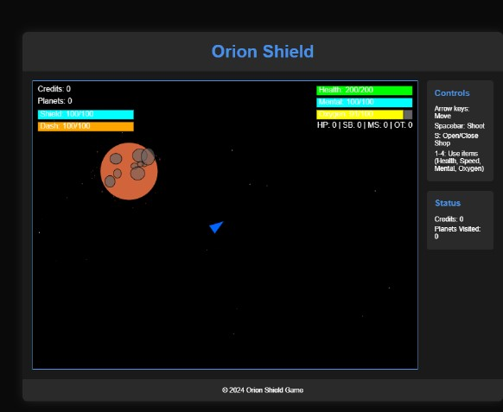
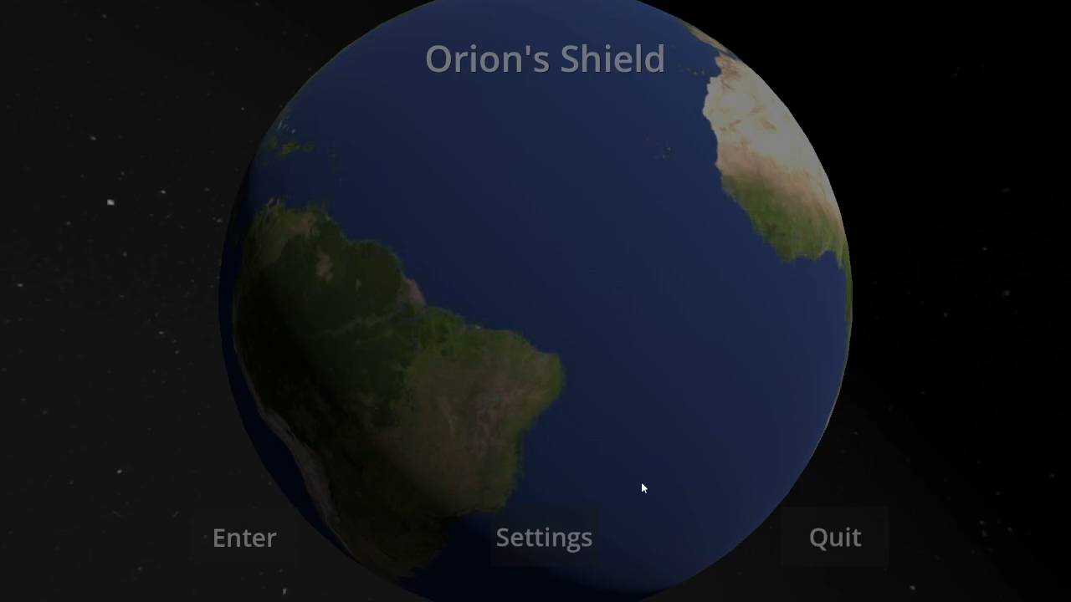
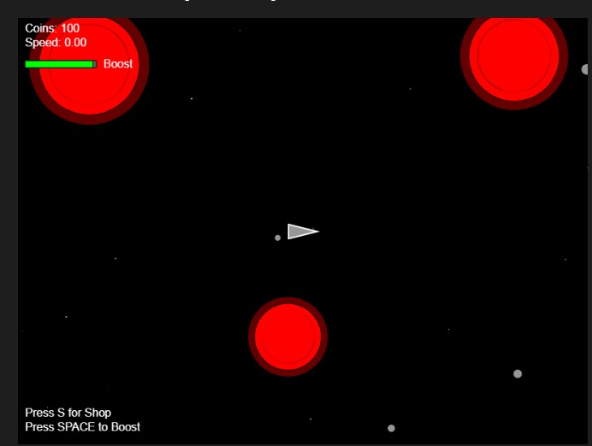


Orion’s shield
Title Screen

Slide 6
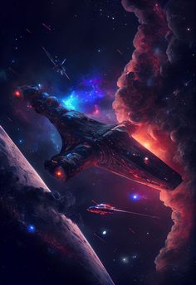
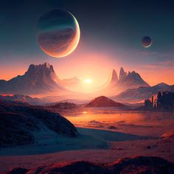
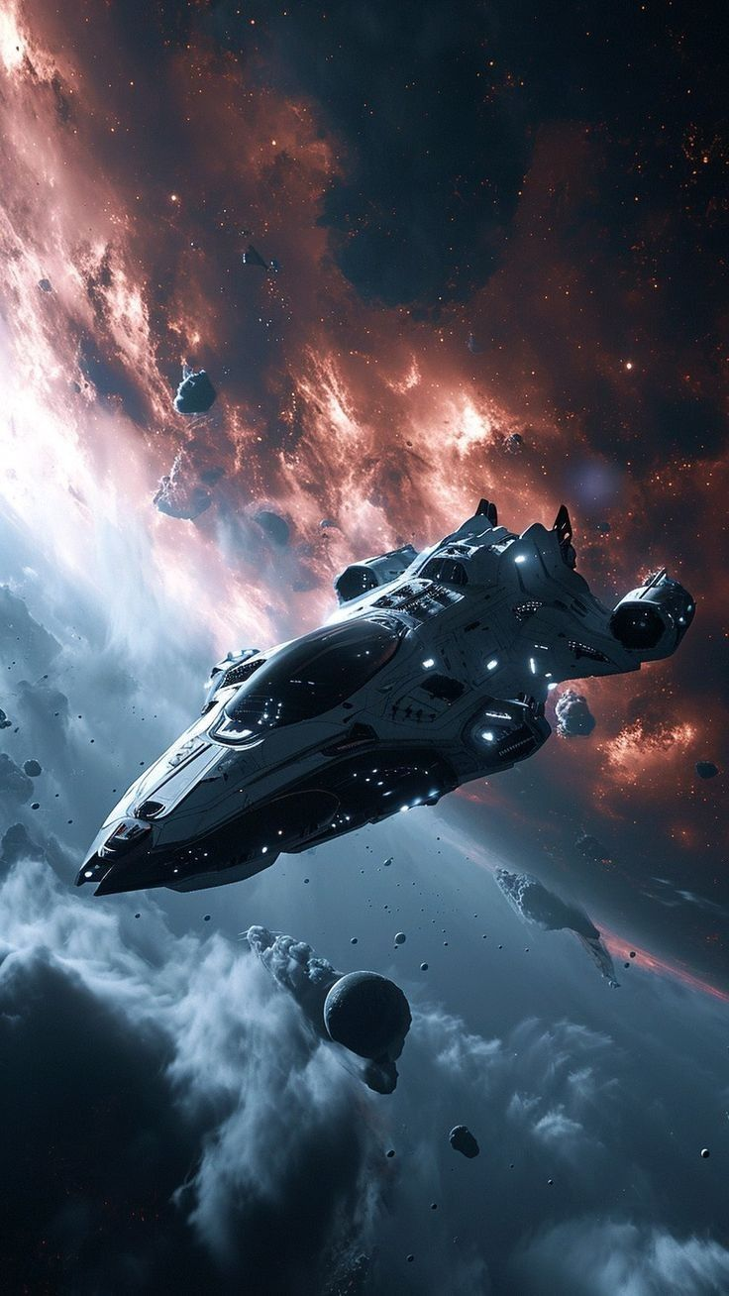
Orion’s shield
Future Work:
Future development of the game will focus on expanding the variety of planetary environments, introducing more complex mental challenges to keep astronauts engaged, and refining the narrative to offer deeper immersion. Additional features may include personalized adaptive gameplay, where the game adjusts to individual astronauts' psychological states to provide tailored experiences that enhance relaxation and mental stimulation. In the future, we plan to port Orion's Shield to VR, offering an immersive experience where astronauts can indulge in the gameplay, tackling the physical aspect of the problem statement. Continuous feedback from astronauts will guide updates, ensuring the game remains effective in promoting mental well-being during long-term space missions.

Slide 7

Citations:
Orion’s shield
Nasa Resources https://www.nasa.gov/wp-content/uploads/2015/05/167746main_fs_livingandworkinginspace508c.pdf
https://www.nasa.gov/learning-resources/for-kids-and-students/what-is-microgravity-grades-k-4/#:~:text=Microgravity%20is%20when%20things%20seem,easy%20to%20move%20heavy%20objects
https://www.nasa.gov/humans-in-space/experiments-to-unlock-how-human-bodies-react-to-long-spacejourneys/#:~:text=the%20following%20themes.-,Bone%20and%20Joint%20Health,after%20landing%20back%20on%20Earth
GoDot Documentation
AI tools used : ChatGpt 4.0 , Gemini 3.5
AI Use : Testing and debugging, researching and framing of sentences.
Images: Google, Britannica

